Slide 1
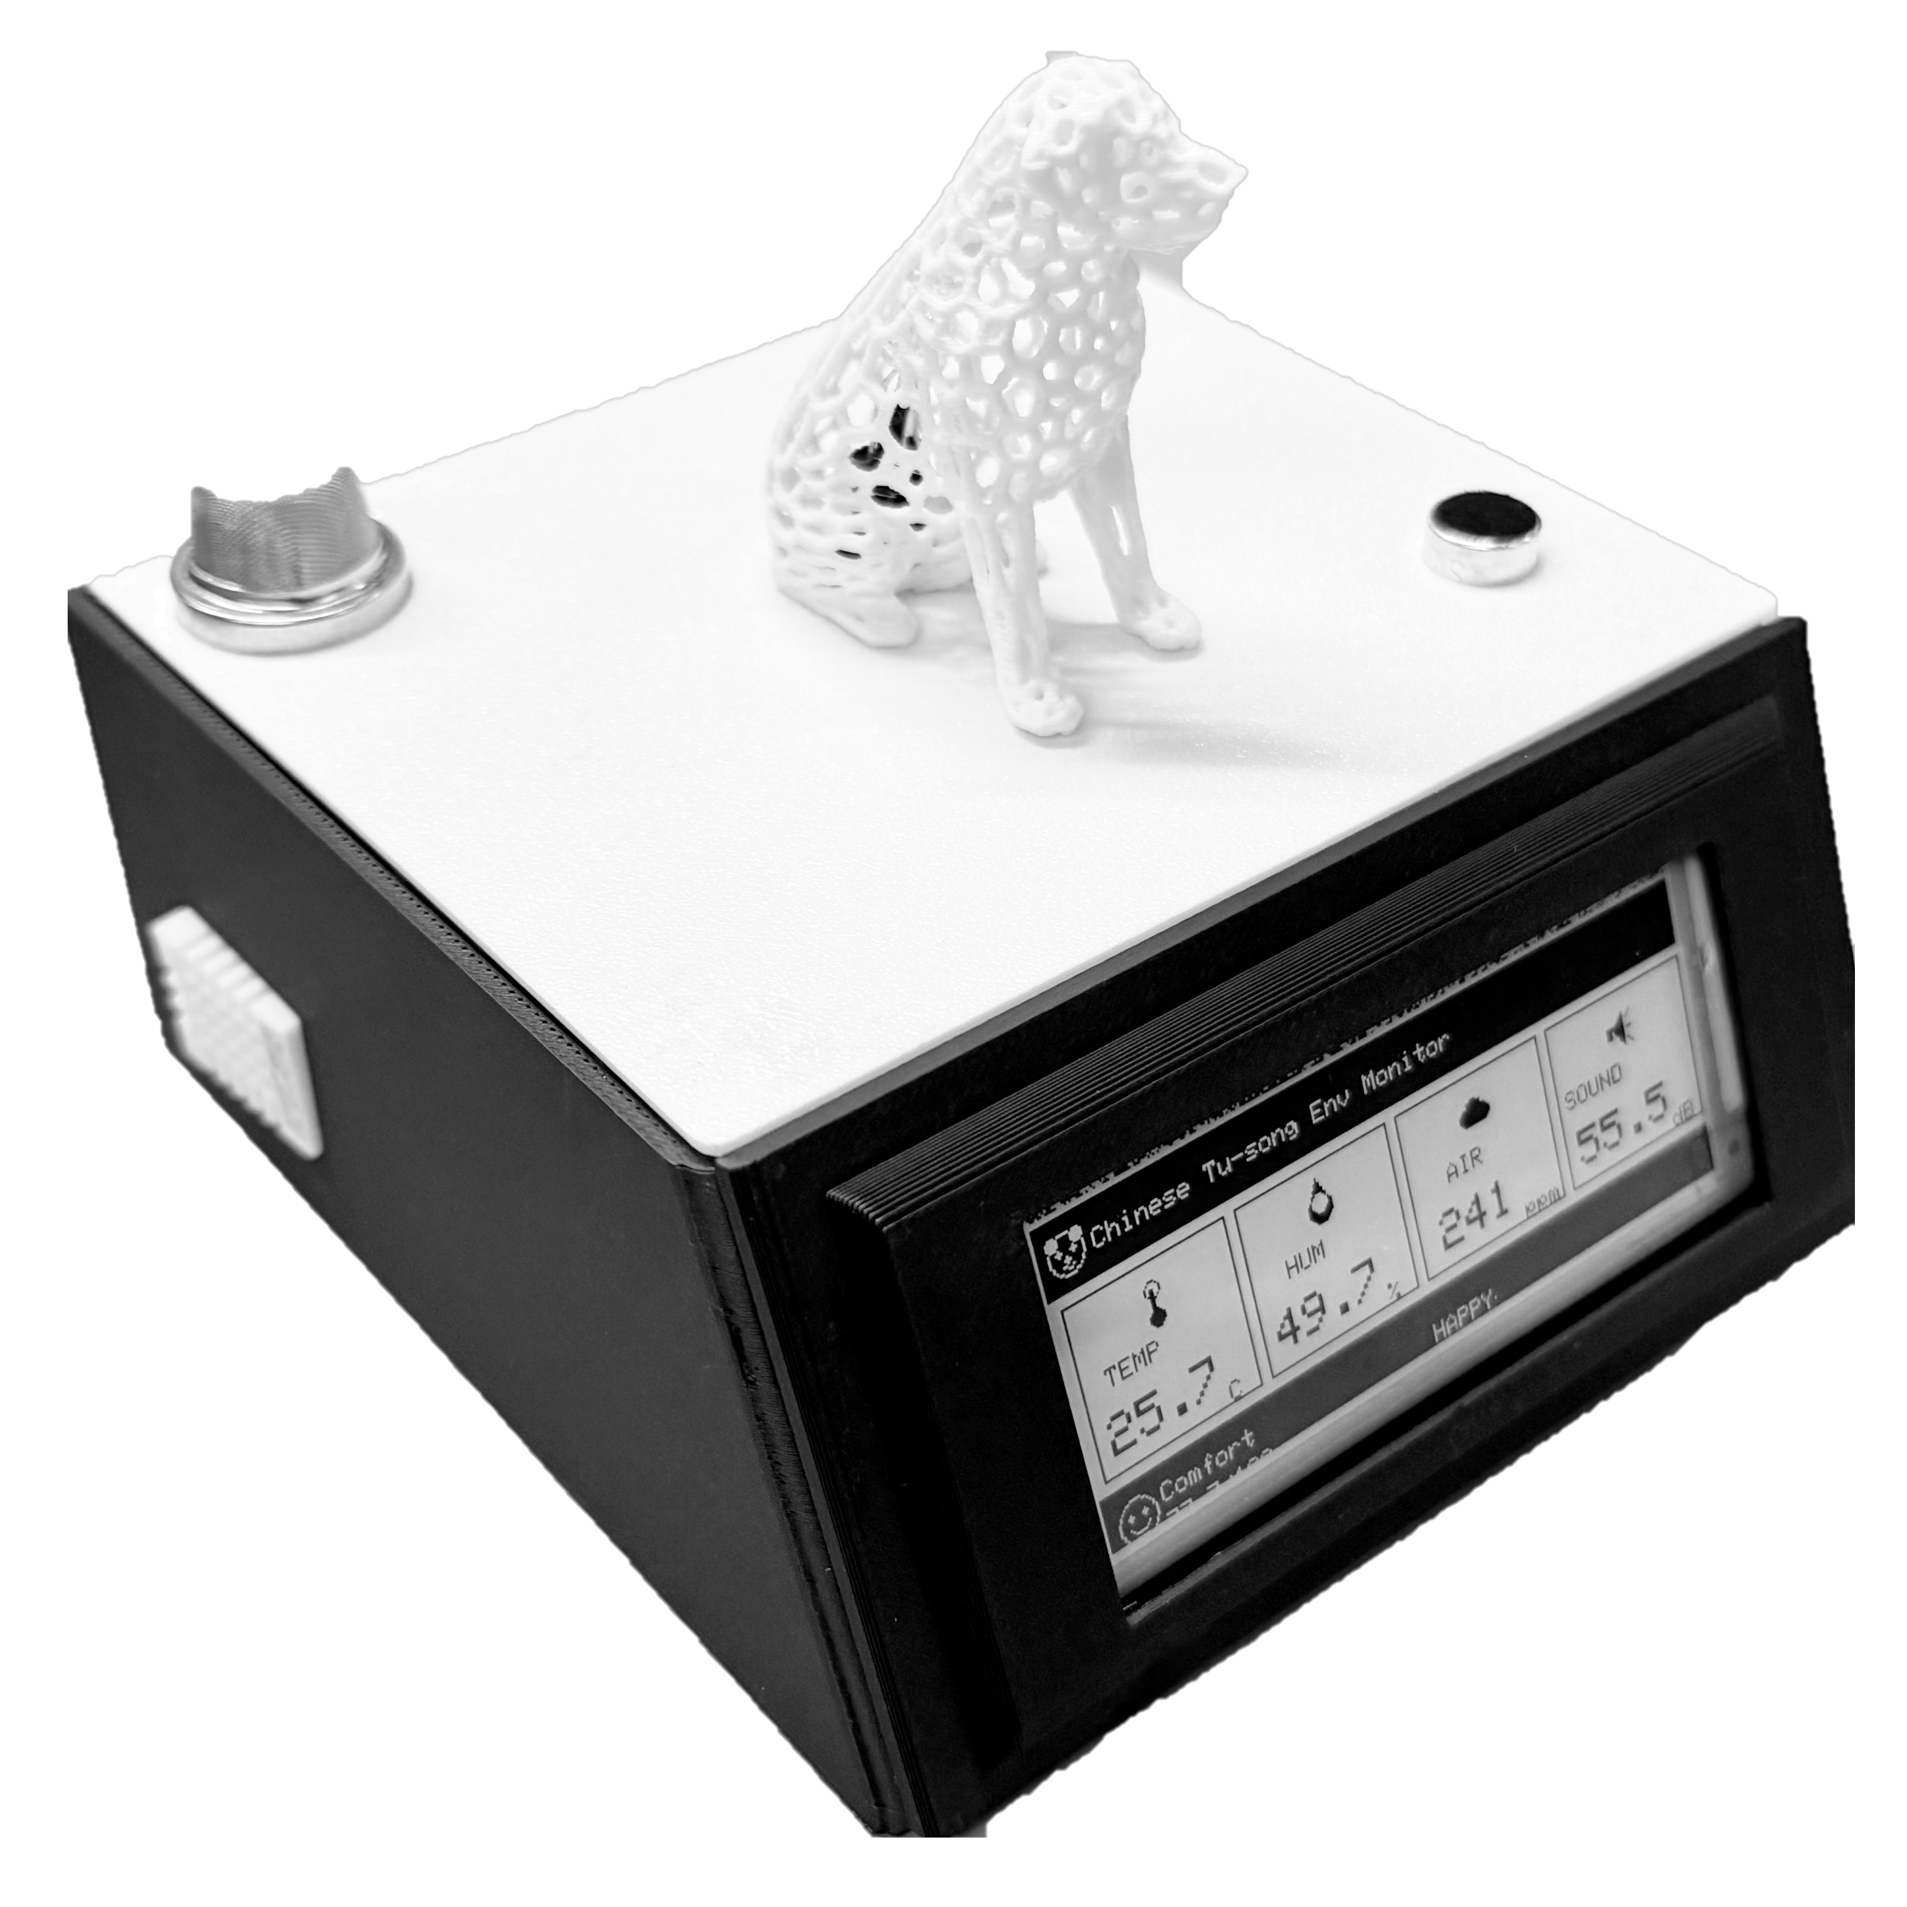
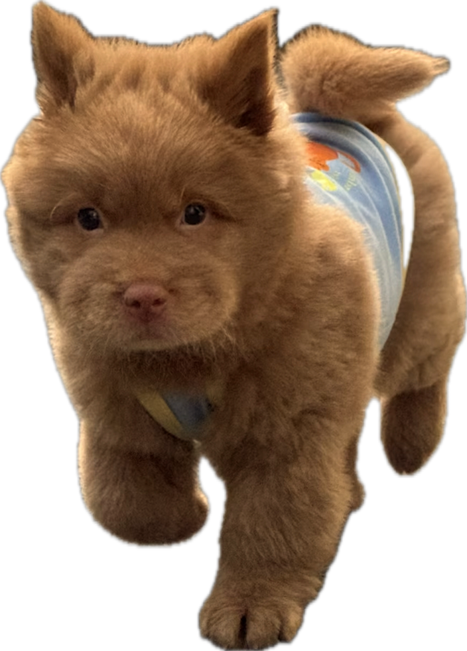
Chinese Chow Chow Dorm Monitor
Lizi Wang
Tu-song
Notes:
I built an indoor comfort monitor designed specifically for small pet-friendly dorm rooms, using gas, humidity, temperature, and noise sensing, with an e-paper display and RGB status light.

Slide 2
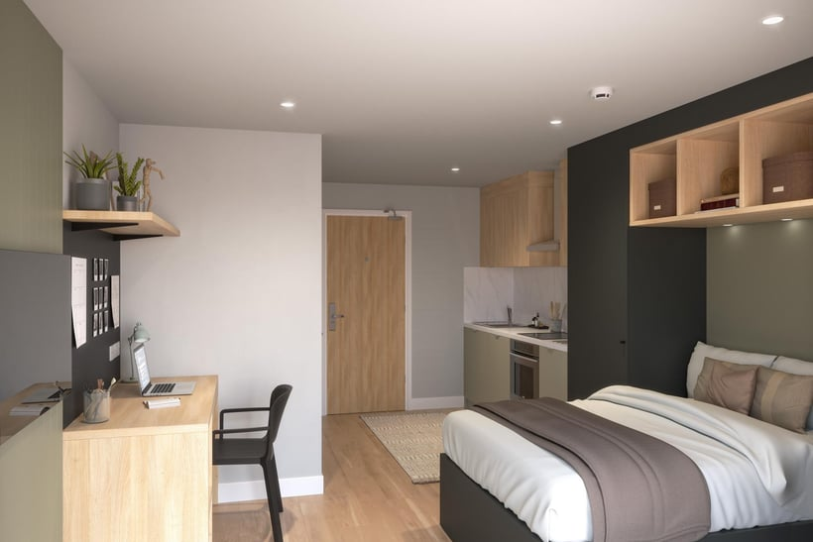
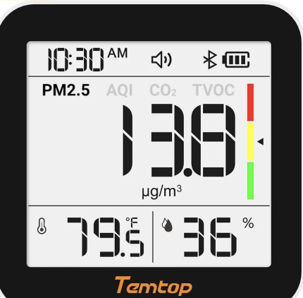
Motivation
Problems in a typical dorm room：
Small enclosed space -> Poor air circulation
Noise levels -> Sleep & living comfort
Existing monitors rarely include noise + gas + visual feedback
Design Goal: A quiet, low-power, pet-friendly comfort monitor that clearly shows air, humidity, temperature and noise levels at a glance.

Slide 3
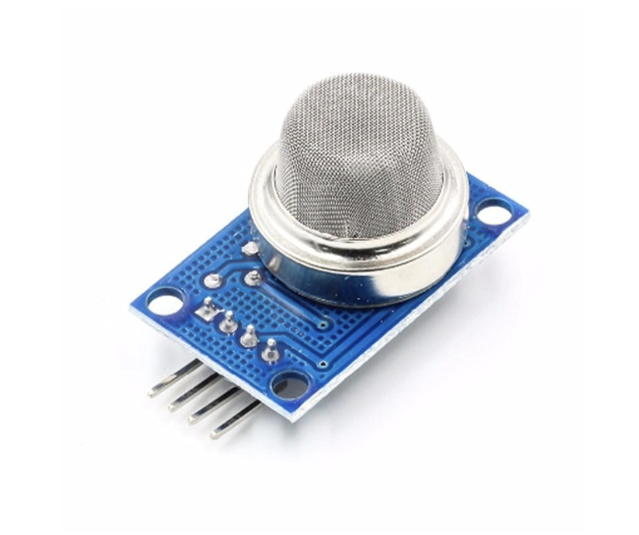
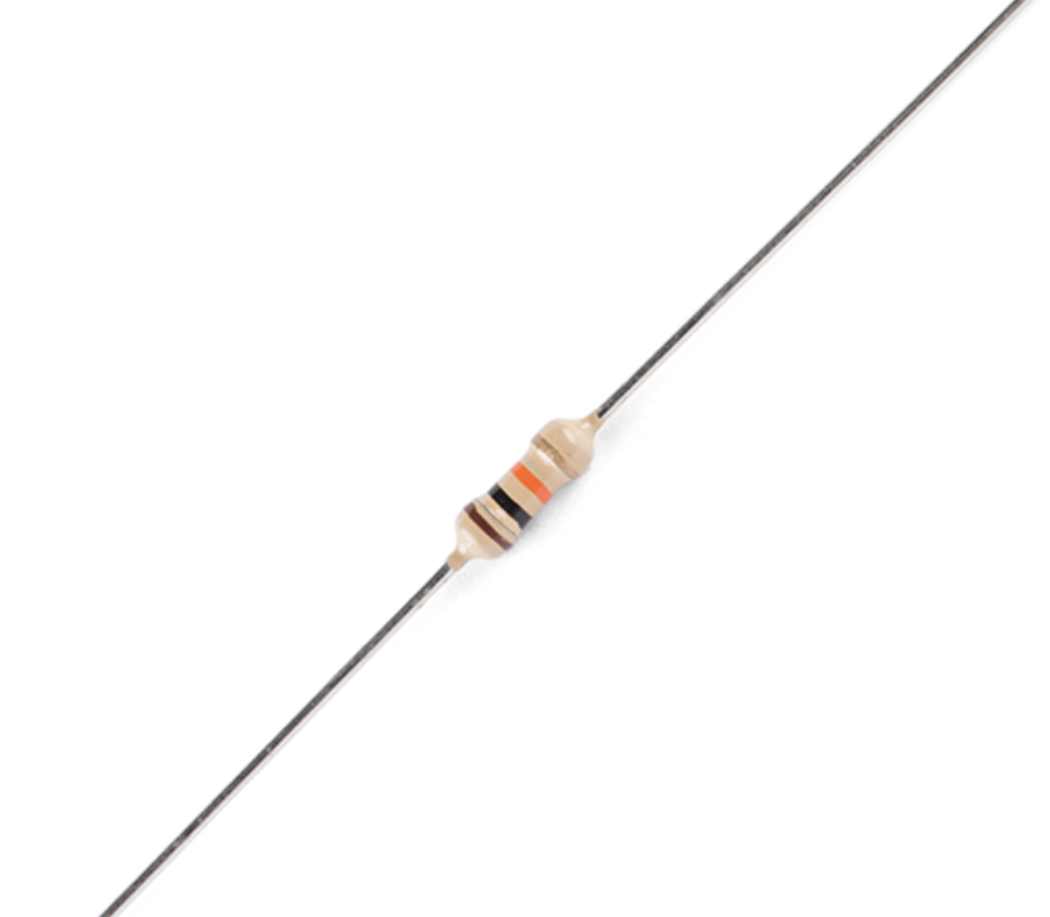
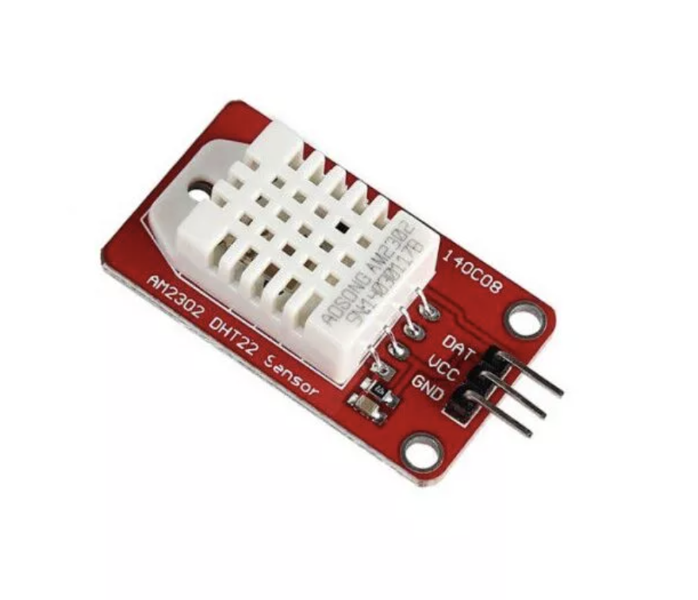
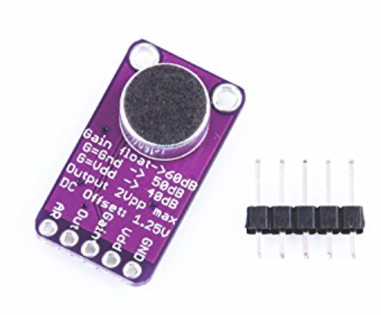
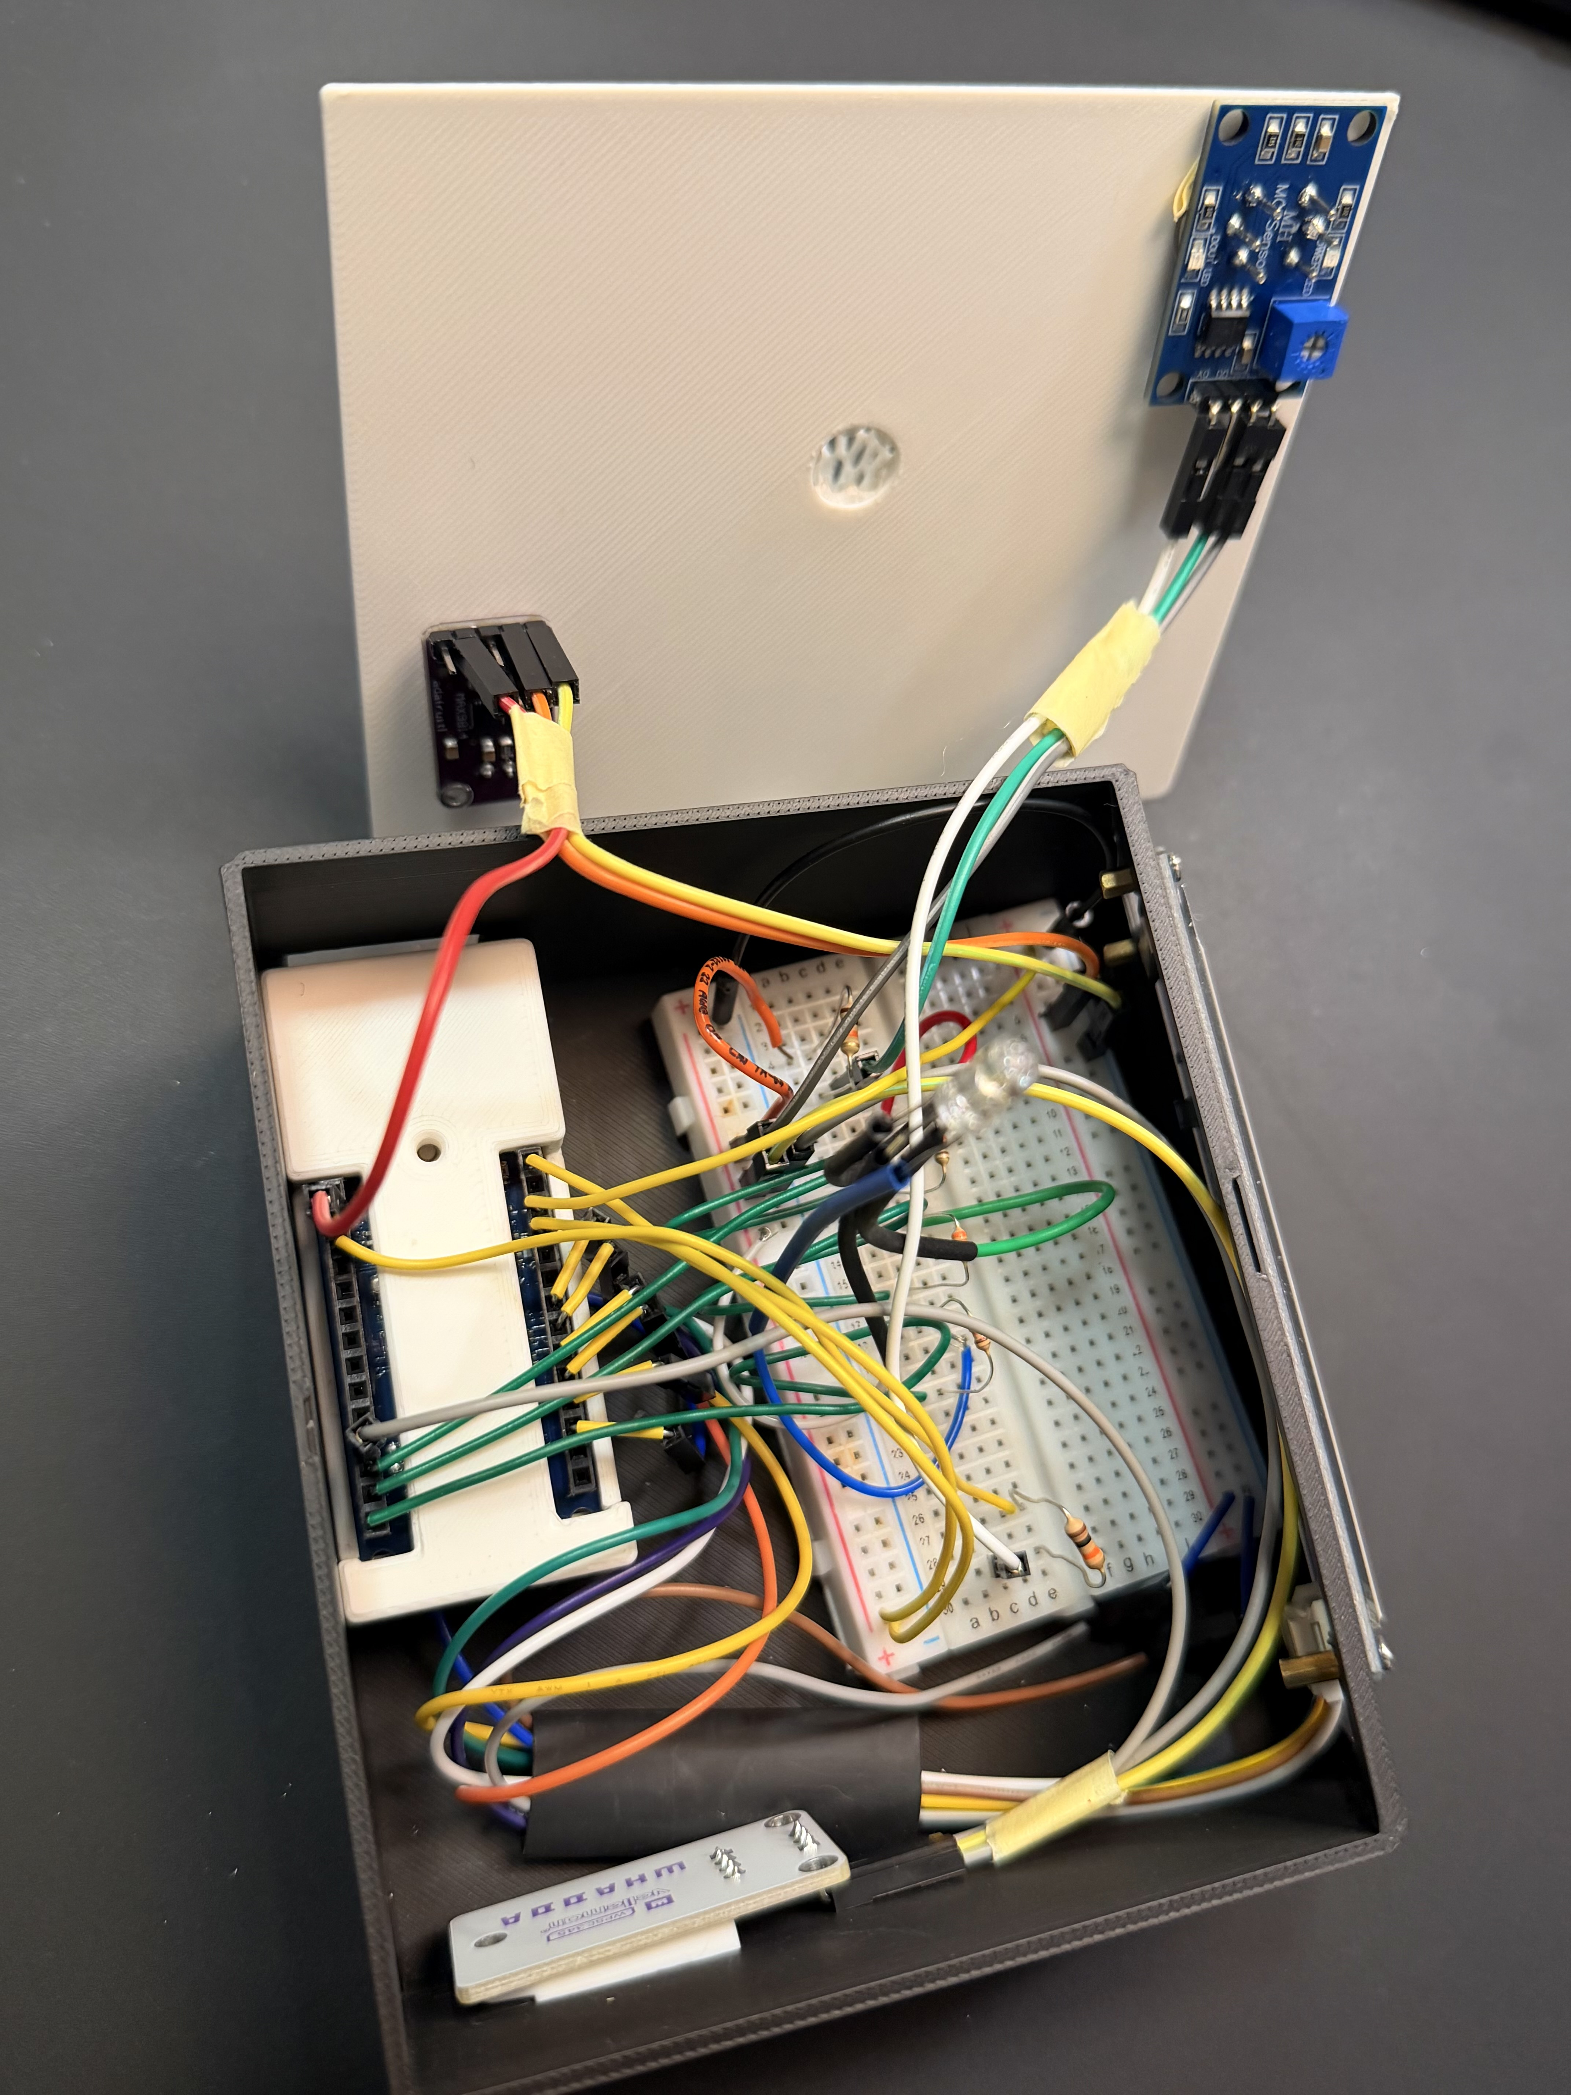
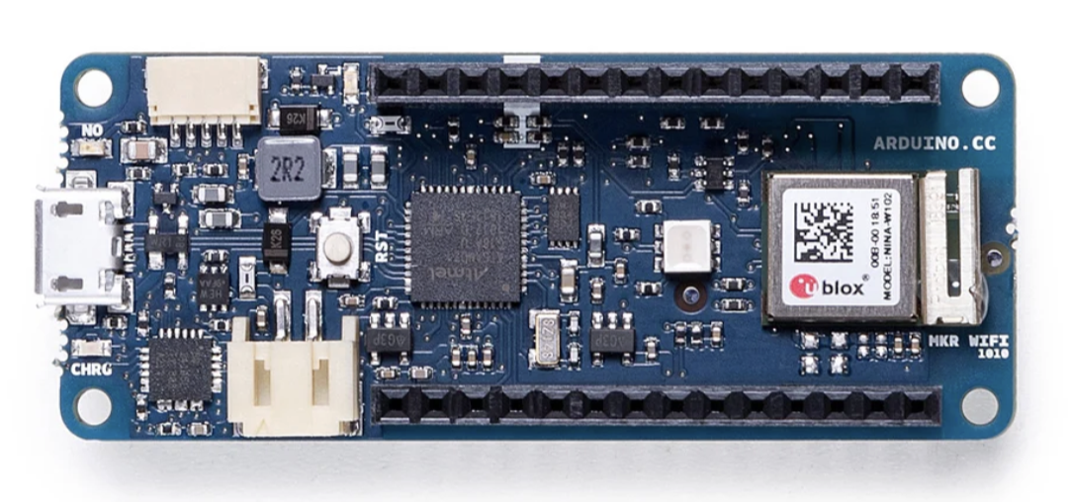
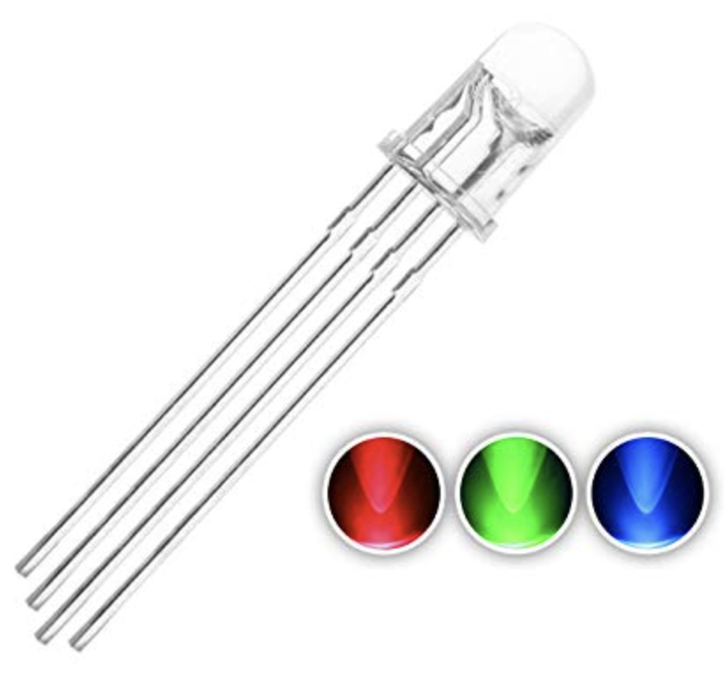
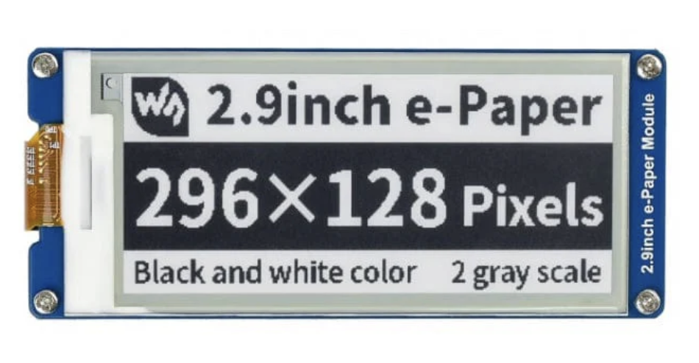
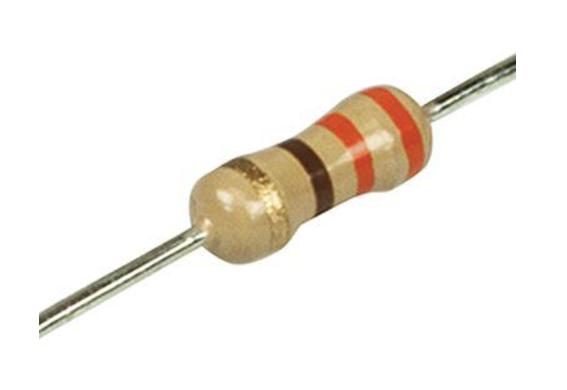
Hardware Architecture & Safety
MQ135 (Gas sensor) + 10kΩ Resistor
5V to 3.3V Logic Protection
DHT22 (Humidity & Temperature sensor)
Precision: 0.5°C accuracy & Wide Range
MAX 9814 (Sound sensor)
Auto Gain Control (AGC) & Sensitivity
Arduino MKR Wi-Fi 1010
32 KB of SRAM and a 32-bit processor
E-Paper 2.9inch
Low Power &
Zero Light Pollution
RGB LED 4 Pin + 330Ω Resistor
LED Current Limiting

Slide 4
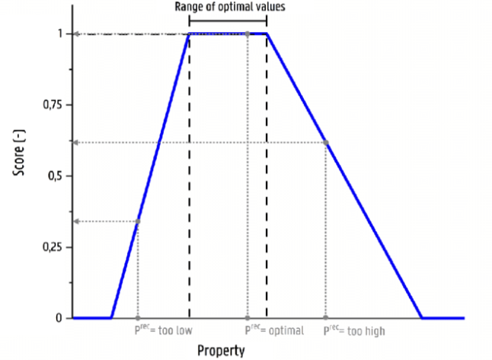
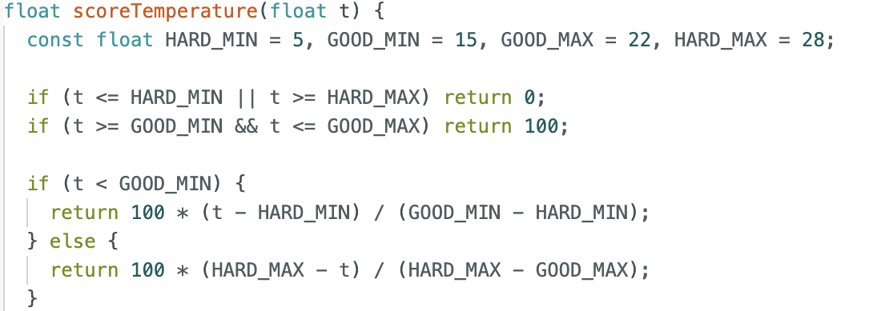
Processing
Comfort Index = 0.3*Temp + 0.3*Hum + 0.2*Air + 0.2*Noise
Respiratory Stress
4x Human Sensitivity
Short
Snout
Real_Voltage = Analog_Read * 2.0
NH3 & VOC -> AQI
Acute
Hearing
Signal Mapping
Low-Pass Filter
Noise_Score = Trapezoidal_Map(dB)
€300
Humidity Intolerant
Heat Intolerant
Double
Coat
& Short
Snout
Double
Coat

Slide 5
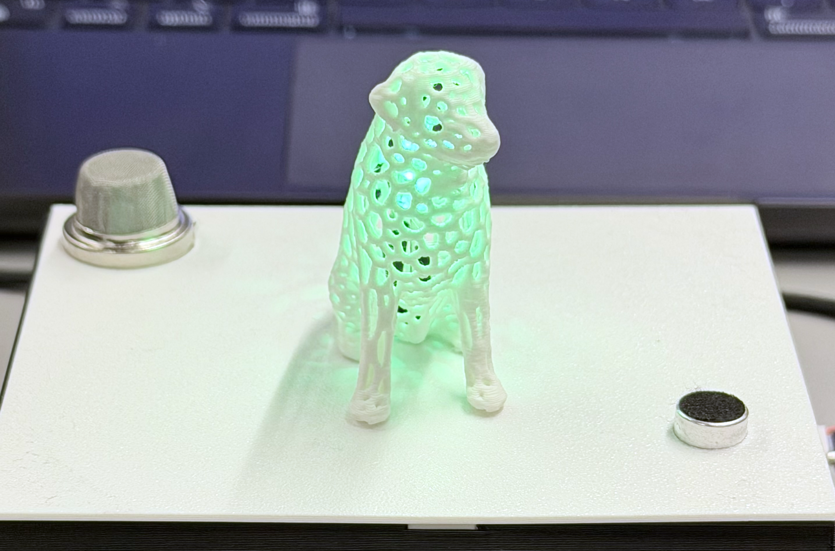
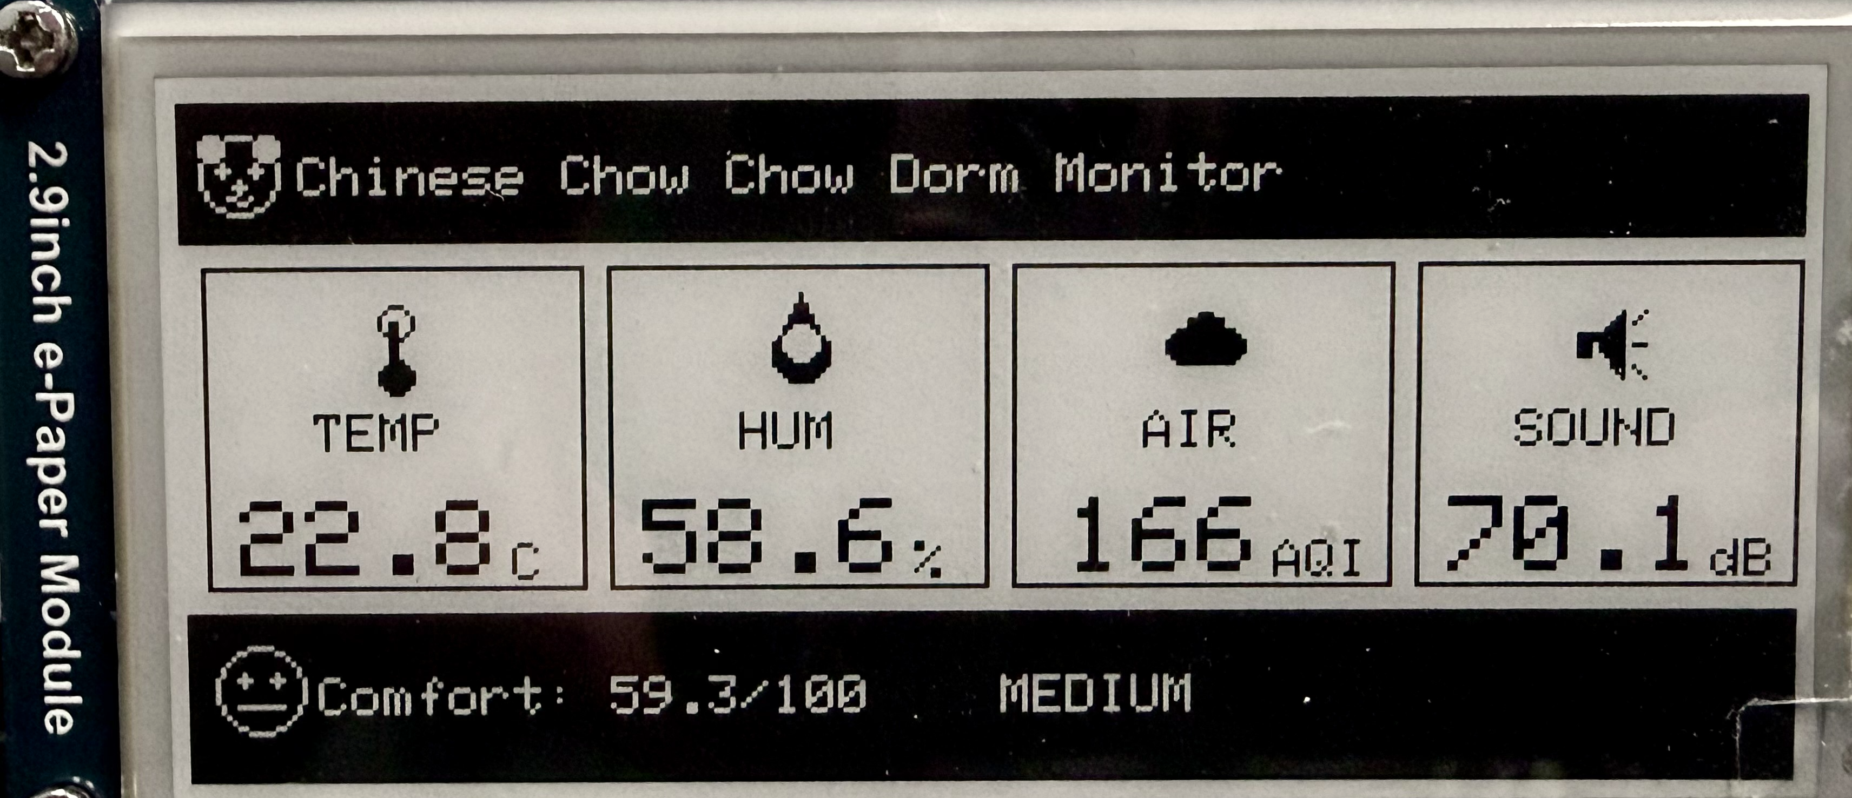
Dual-Layer Feedback System
Real-time (2s) RGB LED
E-Paper Display
Immediate colour feedback (Green/Yellow/Red)
'Auto-Sleep' Logic
'Safety Override' Protocol
Hybrid Refresh Algorithm:
'Event-Triggered' rule
'Heartbeat' rule

Slide 6
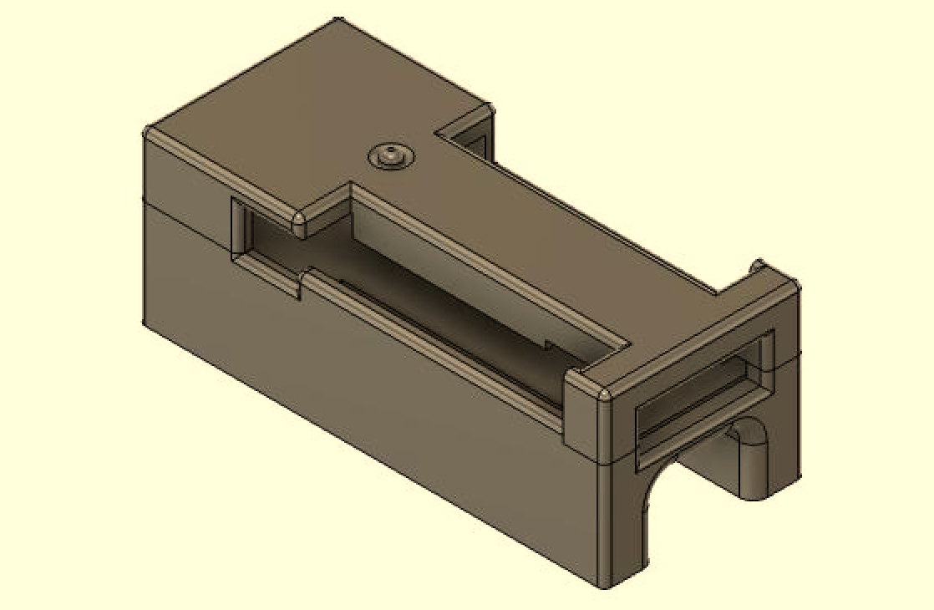
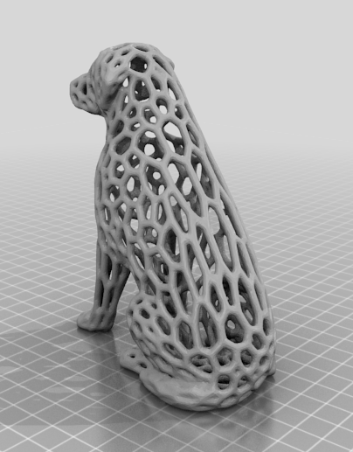
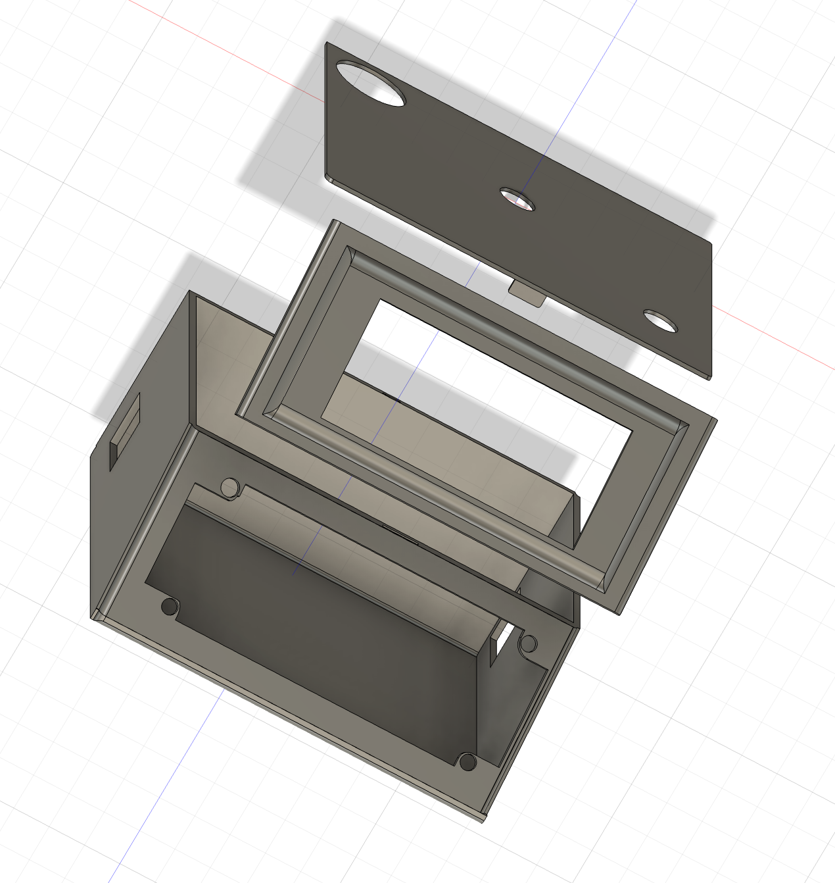
Enclosure: 3D Printing
Half self-design by Fusion 360 & half open-sources model.

Slide 7
Resources
Voronoi Dog: https://www.thingiverse.com/thing:4792489
MKR1010 Case V3: https://www.thingiverse.com/thing:4818736
Tu-song picture: http://xhslink.com/o/35jeLLHAUAB
Dorm picture: https://share.google/fomY15m4CtRzui5o7
Indoor Monitor: https://www.temtop.co.uk/cdn/shop/files/image_1.jpg?v=1716976631
Template designed by Slidesgo.
My Project: https://github.com/Lizzim24/0016_Tusong-friendly_Dorm_Environment_Monitor.git

